Slide 1
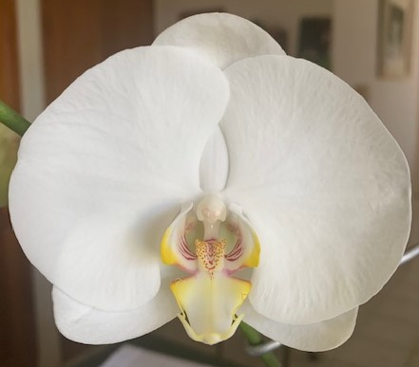
GROWING PHALAENOPSIS
IN TOWNSVILLE NORTH QUEENSLAND
BY CHARLIE TRUSCOTT
Phal. Sharon Truscott 2005

Slide 2
WHAT WE WILL COVER IN THIS TALK TODAY
Potting Media used for Phalaenopsis
Watering
Light
Temperature
Flowering
Staking of Flowers
Diseases
Pests

Slide 3
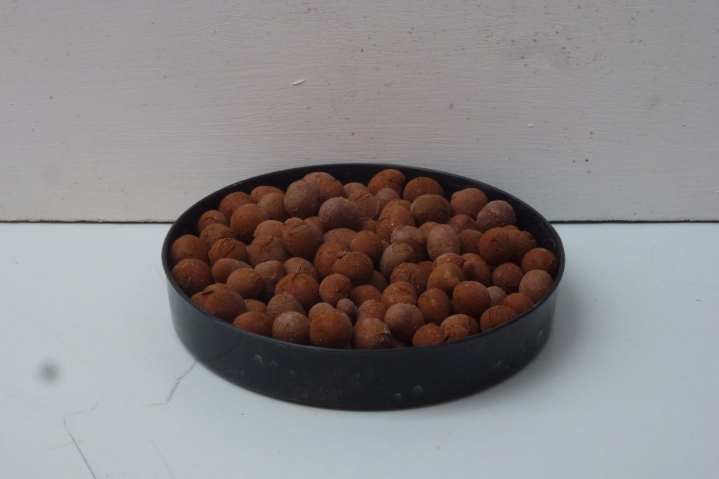
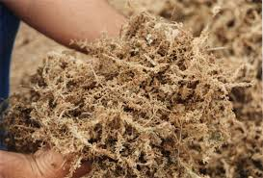
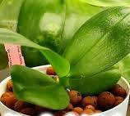
GROWING MEDIA FOR PHALAENOPSIS
8mm-16mm-30mm
USING EXPANDED CLAY BALLS
SEMI-HYDROPONICALLY & SPHAGNUM MOSS
Firstly, what are expanded clay balls and how are they made? They are made from top quality clay medium. The clay is made into clay pellets which are heated to 1200/2000 degrees Fahrenheit. The interior is expanded to a sponge-like form, which provides exceptional absorption of water and nutrients, while the surface is denser, providing strength, while limiting salt build-up. They are inorganic, sterile and will not compact, decompose or harbor mould or disease. The regular shape promotes good air circulation in the root zone, which creates a stronger root system and a healthier plant. It allows humidity around the plant.
Phalaenopsis growing in Clay balls & Sphagnum Moss

Slide 4
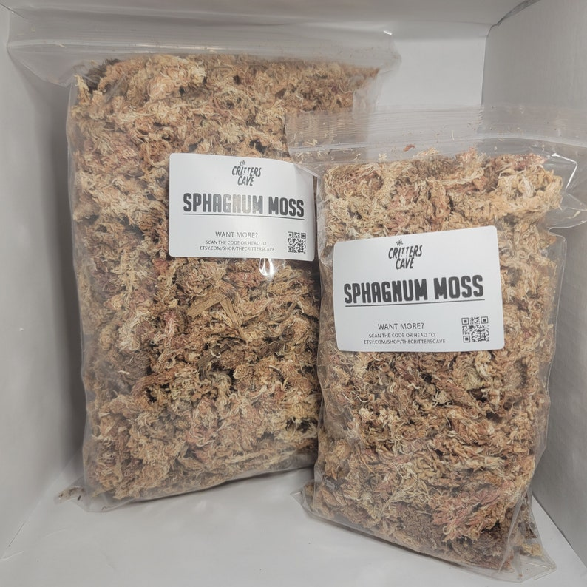
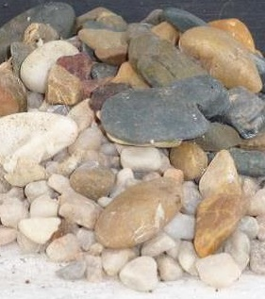
GROWING MEDIA FOR PHALAENOPSIS
SPHAGNUM MOSS …
It is the soft, spongy moss found on the surface of bogs. It is capable of holding ten times its weight in water. Sphagnum moss has an antiseptic quality that inhibits ‘damping off’ fungal disease. It is a very good aid to ailing plants and seedlings, a helpful medium to nurse along otherwise reluctant orchids. Water weekly, but in hot weather more frequently. DO NOT LET IT DRY OUT. A complete fertilizer is required. Water when almost dry.
GRAVEL/STONES
They are an inert, inorganic aggregate that does not decompose and when used in mixes, it resists decay and improves drainage and aeration. Because of its weight it helps to keep the newly repotted plant upright. It has no nutrients, they are used in a more hydroponic role and needs a complete balanced fertilizer. There is no breakdown with this product.

Slide 5
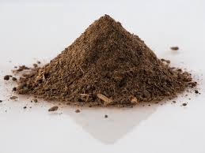
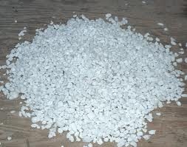
POTTING MIXES USED FOR PHALAENOPSIS
PEAT
Peat moss is more suitable for orchid growing than horticultural peat. It has a PH range from 3.5 to 5. Granulated peat moss can hold at least seven times it weight in water. A mix of 50/50 of peat moss to perlite has been proven to be ideal. Water once a week and use a complete fertilizer.
PERLITE
It is a specially processed, everlasting volcanic material, easy to work with, easily obtained, drains and aerates well and does not break down. It does not compact, keeps mix loose and helps water retention. Mainly used with peat, sphagnum moss, coco fibre and bark. A complete balanced fertilizer is required.
When this product is handled dry, a mask is required because the dust can infect the lungs. It is recommended that it be washed before using

Slide 6
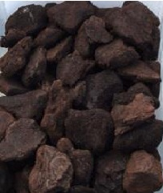
GROWING MEDIA FOR PHALAENOPSIS
PINE BARK It is a natural medium, used more than any other potting material. It can be used untreated, but this is not recommended. Bark that is being used today has been treated in one of the following ways:
Boiled – Composted – Limed – Aged.
These treatments are used to remove the oils and resins from Australian barks, and to raise the PH on the bark surface. New bark can take a lot of watering to thoroughly wet the bark surface - using a wetting agent does help. Bark can rot or decay with age, it requires slightly higher nitrogen fertilizer than most other potting materials. Life span is about 1 to 2 years.

Slide 7
DISADVANTAGES OF USING BARK AS A POTTING MIX
Other Disadvantages of using bark
Without sufficient ventilation bark promotes the spread of bad bacteria, that not only smell bad, but the resulting root rot, can destroy the entire root system and the plant.
Needs watering more often, poor water holding ability.
Bark accumulates fertilizer that can burn roots over time. Need to flush out pot more often.
After about 12-18 months the pH level of bark becomes very acidic, which hinders the development of the plant, so re-potting is needed at that time, with the old bark being unable to be reused.

Slide 8
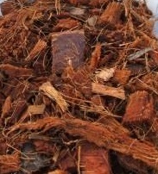
GROWING MEDIA FOR PHALAENOPSIS
COCONUT CHUNKS
Coconut Chunks is the long lasting, thick coarse organic fibre from the outer husk of the coconut. Coconut fibre is quick draining and capable of holding twice its weight in water. It does not break down quickly, aerates well, is cost effective and particularly effective in resisting rot, fungus and other infestations. A complete fertilizer is required. Life span is 2 to 3 years. Water less than bark.
Important - Wash and soak in water to eliminate any impurities and residue salt.

Slide 9


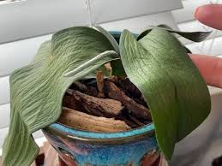
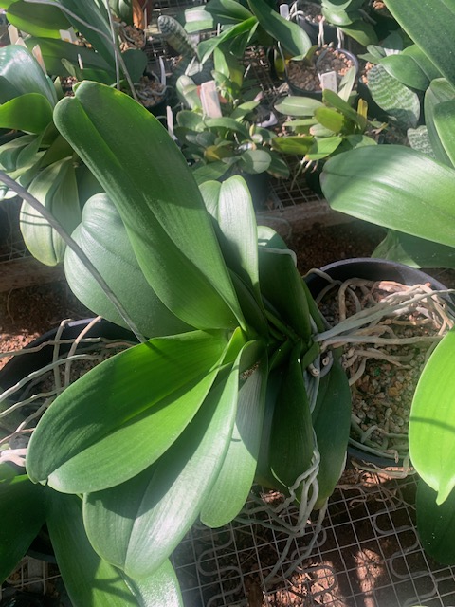
WATERING OF PHALAENOPSIS
How often should you water depends on: 1. Potting Mix
2. Amount of light and Heat plant receives
3. Environment, for example subject to breezes,
shaded areas, height from ground and roof.
When should you water - Early morning preferably – To allow plant to dry out and avoid
water laying in the crown of the plant.
How do you know when your Plant needs watering - One way is a Moisture metre
WARNING
Avoid leaving water in the crown, especially overnight,
as plant may get Crown rot. Use Paper towel, paper
coasters, blotting Paper, or simply blow out water from
crown with a straw.
Phalaenopsis Crown

Slide 10
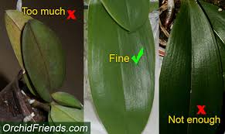
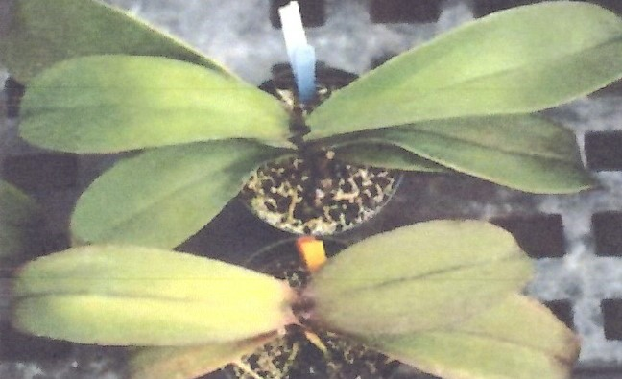
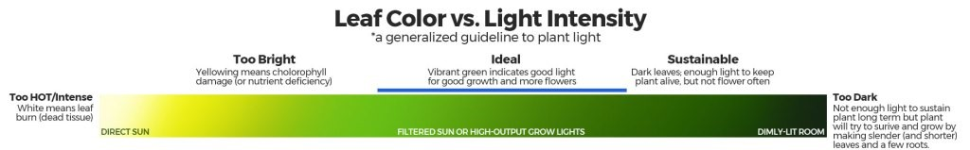
HOW MUCH LIGHT DO YOU GIVE PHALAENOPSIS
Too much
Phalaenopsis are LOW light orchids
How do I know if my orchid is getting enough light?
Leaf colour is a good indicator of the amount of light a plant is receiving. Orchids should have bright green, healthy leaves. Dark green leaves indicate that a plant is getting insufficient light, and yellowish-green or red leaves indicate that a plant is getting too much light.

Slide 11
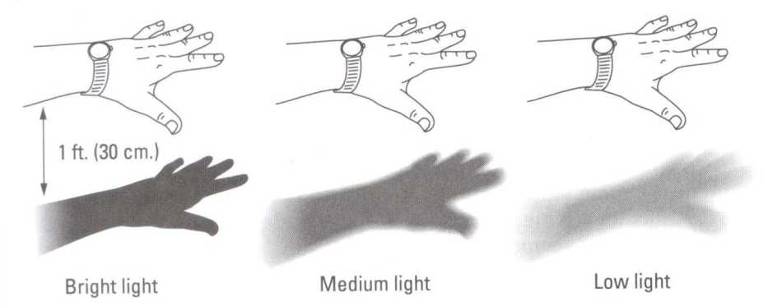
LIGHT FOR PHALAENOPSIS CONTINUED
Ideal for Phalaenopsis
Light level Measurement – Hand Shadow Method

Slide 12

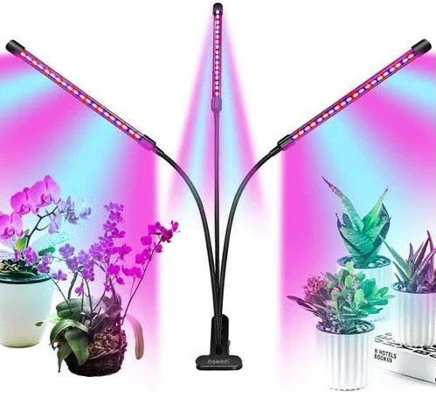
LIGHT FOR PHALAENOPSIS CONTINUED
If using a LUX or Light meter
Lux is the scientific measure of the intensity of light that hits a surface, measured in lumens per square meter Ideally, phalaenopsis orchids should get about 10700 to 16000 lux for at least 8 hours per day, for optimal growing.
Hydroponic LED grow lights for indoor applications, are the most efficient, least expensive, and common type of hydroponic lights available. LED bulbs use less energy and last longer than other types of bulbs, so they are a good choice for grow lights. They also generate much less heat, making them safe for plants.
Blue Light Spectra
For Growth
Red Light Spectra
For Flowering

Slide 13
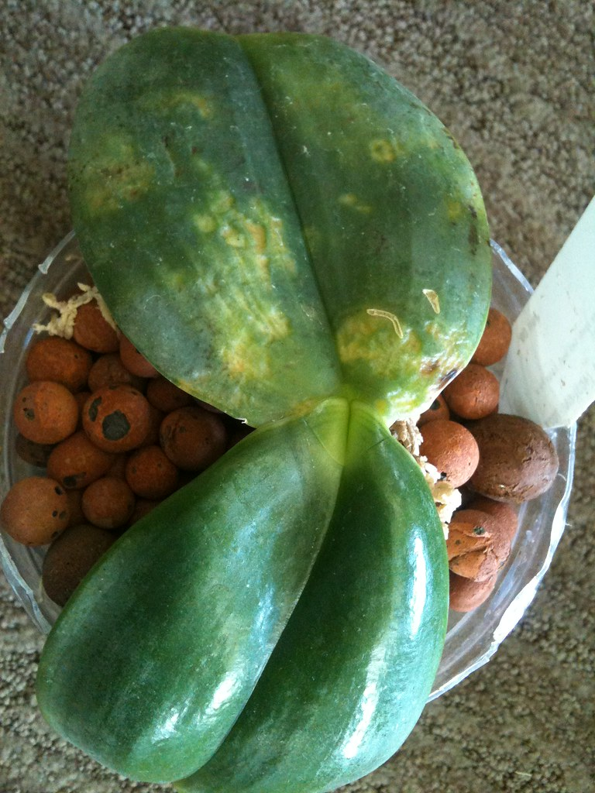
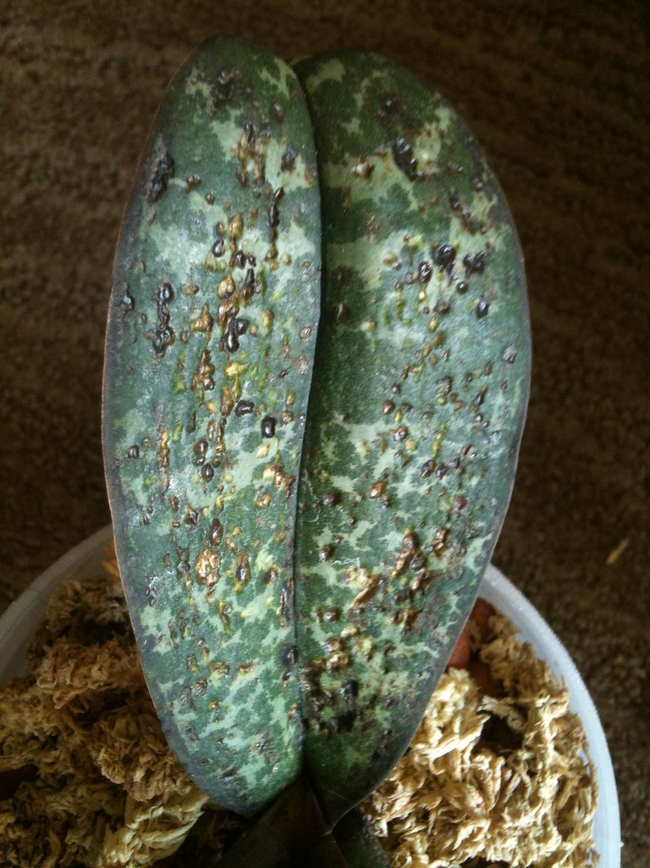
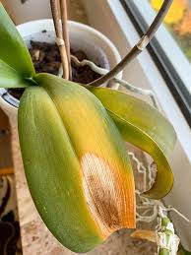
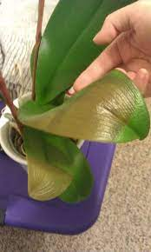
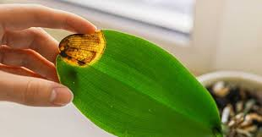
TEMPERATURE FOR PHALAENOPSIS
Generally Phalaenopsis are easy to grow in Townsville
Because they enjoy the same temperatures we do.
In summer temperatures can range from 25°C to 35ºC
And Winter from 15ºC to 28ºC.
In areas like Mackay, Rockhampton and further
South they can experience temperatures below
4ºC and are subject to frosts.
Frost Damage
Townsville Summers can take their toll on
Phalaenopsis with temperatures that can reach
45ºC, be careful to avoid Sun Burn, Heat Stress
And Dehydration.
Sun Burn
Heat Stress
Sun Burn

Slide 14

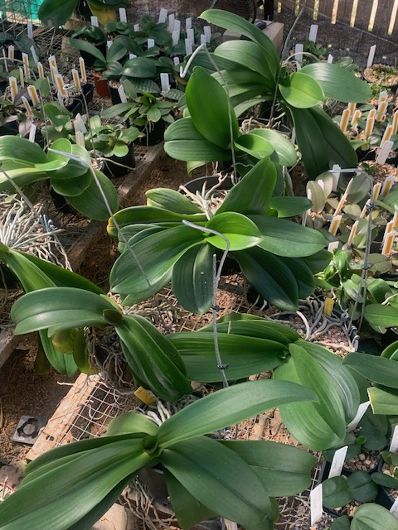
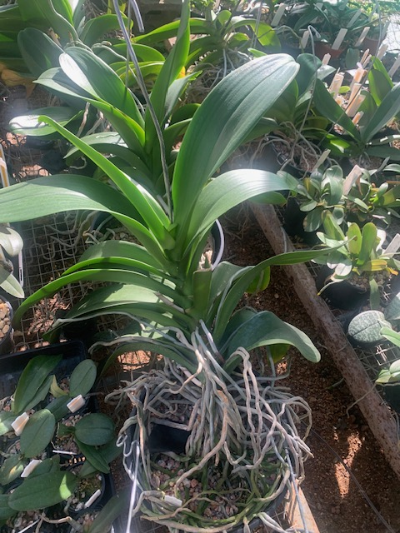

OVERCOMING HEAT RELATED PROBLEMS IN PHALAENOPSIS
Increase air movement with fans
Increase Humidity by misting and wetting
Floors underneath Plant regularly
3. Lower plants closer to ground
Add more shade cloth
Do not house on Western side
Of green house.
Spray Envy, a Bio-Shield Polymer
on top and bottom of leaves to
protect from Heat stress and sun burn.

Slide 15
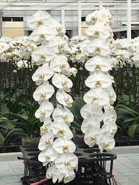
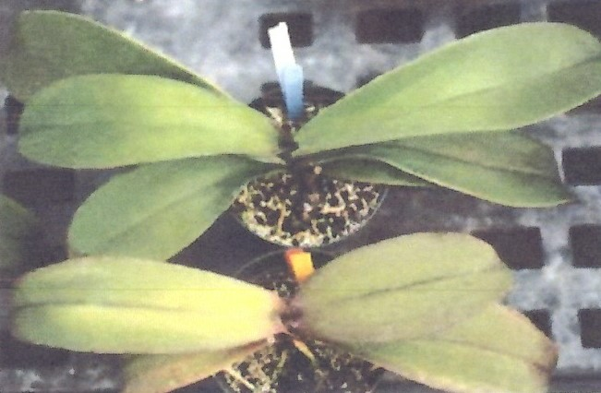
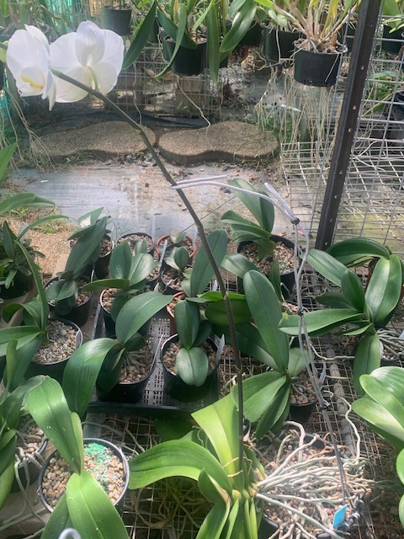
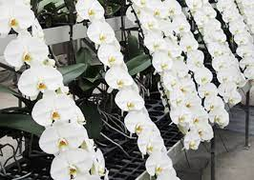
FLOWERING PHALAENOPSIS
A day-night temperature difference of 5 to 10 degrees C is necessary to trigger orchid reblooming. Add extra Light.
Epsom salt into your orchid care routine is a great way to increase the size of your blooms. It will also help the vigour of your foliage.
Add a balanced flowering fertilizer to your feeding programme,
Like Peters 10 N 10 P 10 K.
Allowable staking
To First flower only
Plant Nutrient deficient
Incorrect staking

Slide 16
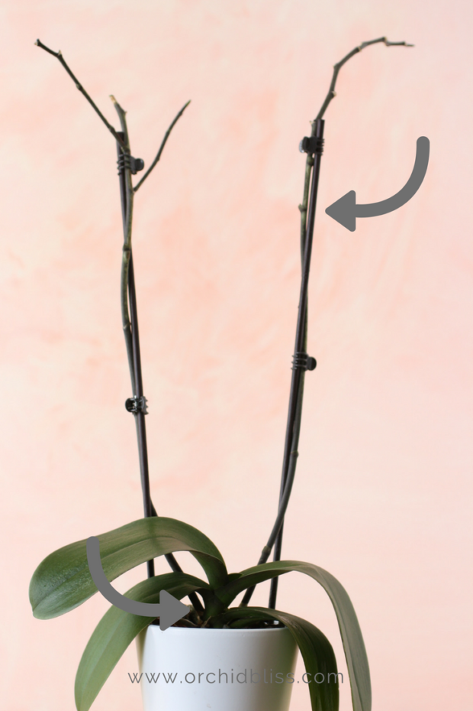
CUTTING OF OLD FLOWER SPIKES
Sterilize the Scissors
Before using the scissors, make sure they’ve been sanitized. This may seem like an unnecessary step, but it will help keep your orchids healthy by preventing viruses and other pathogens from being passed between orchids. Think of yourself as a sort of orchid doctor There are two ways to accomplish this: Trisodium Phosphate ( Available from Club shop) or a flame.
Cut here above node for branching and more flowers
I DON’T RECOMMEND CUTTING AT THE NODE, AS THIS WILL PRODUCE MORE FLOWERS, AND THE PLANT NEEDS ITS NORMAL DORMANT PERIOD TO RECOVER. THIS WILL ONLY STRESS THE PLANT MORE
Cut here 10mm or ½ inch from base

Slide 17

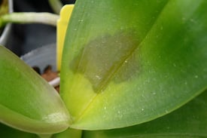
DISEASES OF PHALAENOPSIS
Black rot or Black Spot Fungus
Anthracnose and phytophthora (also called black rot or black spot) are common fungal diseases affecting orchids. Anthracnose usually exhibits a problem by leaves turning black from the tips toward the base. Phytophthora is often displayed as dark lesions on the leaves that grow larger and spread toward the roots.
Bacterial Soft & Brown Rot - Pectobacterium (syn. Erwinia)
Symptoms: Small water-soaked spots appear on the leaves and often are surrounded by yellow halos. If unchecked, the infection will rapidly rot the leaves and roots and spread more slowly into the rhizomes or pseudobulbs. This wet rot may have a foul odour and has a water soaked appearance.
The Fungus Disease spreads so rapidly that plants may be completely rotted in 2 to 3 days. The bacteria are opportunistic organisms that can enter through wounds.
Bacterial Soft & Brown Rot

Slide 18
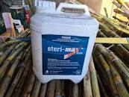


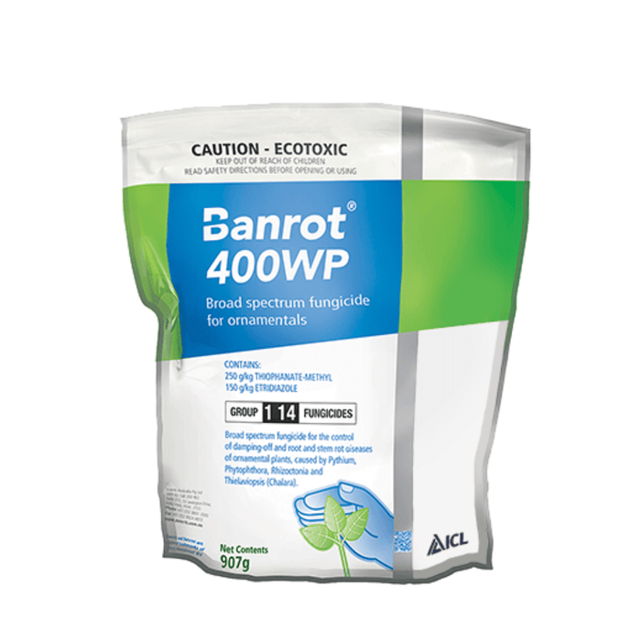
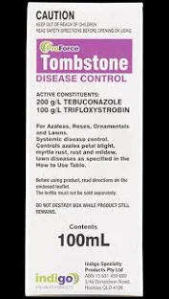
TREATMENT FOR SOFT AND BROWN ROT ON PHALAENOPSIS
Treatment: Immediately remove infected tissue using a sterile instrument, seal area with a combination of Mancozeb and Ground Cinnamon. Spray bactericides Steri-Max, Path-X or Alginox. on infected and adjacent plants following label instructions of a 1ml/1ltr.
Spray monthly with a good broad-spectrum fungicide like
BanRot WP400 or Tombstone
Prevention: The disease is spread by splashing water so avoid overhead watering if the disease is present. The pathogen favours hot and moist conditions, so if infection occurs, keep leaves dry, increase air circulation and reduce temperature and humidity (if possible). Periodic preventive sprays Steri-Max, Path – X or Alginox help to prevent infection, particularly during hot and humid weather.

Slide 19
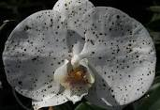
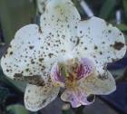
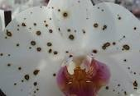
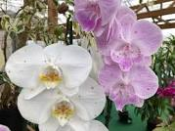
BOTRYTIS CINEREA FUNGUS
On Phalaenopsis flowers, this disease is caused by Botrytis cinerea, it causes unsightly brown spotting of blooms. The fungus most often affects Phalaenopsis and Cattleyas, but may be found in a wide range of orchid genera. Older flowers are highly susceptible to infection.
The fungus winters primarily on dead and dying plant material, and begins producing and dispersing spores during cool, damp weather, or heavy dew, in the spring or autumn. Damp conditions, rapidly rising humidity or disturbing infected plants may release spores into the surrounding growing area. Spores can be distributed by wind, rain, dust or any mechanical action e.g Strong breezes. Temperatures in the midrange (18°C–23°C), and wet plant surfaces or ambient humidity of at least 92 percent, are ideal conditions. The fungus can proliferate very quickly, infecting healthy plant tissue in as little as 14 hours.

Slide 20
CONTROLING BOTRYTIS FUNGUS ON PHALAENOPSIS FLOWERS
FUNGICIDE
Control
Once the botrytis spotting occurs, there is no removing it — only preventing future occurrences. A fungicide such as thophanate methyl Banrot WP400, kills rather than suppresses target pathogens or bactercides (which kill Bacteria) like Steri-Max, Path-X and Alginox can be applied as needed to prevent further outbreaks. Since the infection primarily affects flower petals, many growers do not recommend the use of fungicides. As with any chemical, always use it in strict compliance with the manufacturer’s instructions.
Thiophanate Methyl
Alginox
Watering
When watering, avoid wetting the plant and its flowers, if possible. Water that remains on petals or leaves after a rain or watering encourages fungal growth. Watering early in the day, helps ensure that the plant and its flowers will be dry by nightfall. Never allow blooms or foliage to remain wet overnight.
Steri-Max
BACTERCIDES
Path-X

Slide 21
CONTROLING BOTRYTIS FUNGUS ON PHALAENOPSIS FLOWERS
Sanitation
Inspect the growing area for conditions favourable to botrytis. As this pathogen thrives and winters over on dead and dying plant material, remove any plant debris, spent or fallen flowers and leaves from the growing area to reduce the possibility of spreading the fungus. Some growers recommend removing and disposing of all affected flowers to help prevent the spread of the fungus, and even burning or burying of affected plant tissue.
Circulation
Keep plenty of fresh air moving through the growing area and around plants at all times. A stagnant, damp environment with inadequate air circulation promotes the growth of botrytis. Good air circulation is a necessity to prevent fungal infections year round, but most especially when plants are in bloom. Increasing the ambient temperature and air movement and decreasing the humidity during cool, damp weather will help eliminate any excess moisture on plant tissue, thus minimizing the chances of infection. In most areas, orchids grown outdoors already have the necessary air movement in their environment.

Slide 22
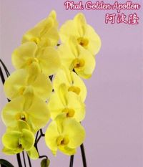
CONTROLING BOTRYTIS FUNGUS ON PHALAENOPSIS FLOWERS
Finally, isolate any new plants for a minimum of two weeks before admitting them to your growing area and into your orchid collection. During the isolation period, keep a close eye on the new acquisition for signs of any pest or disease that could be spread to other plants.

Slide 23
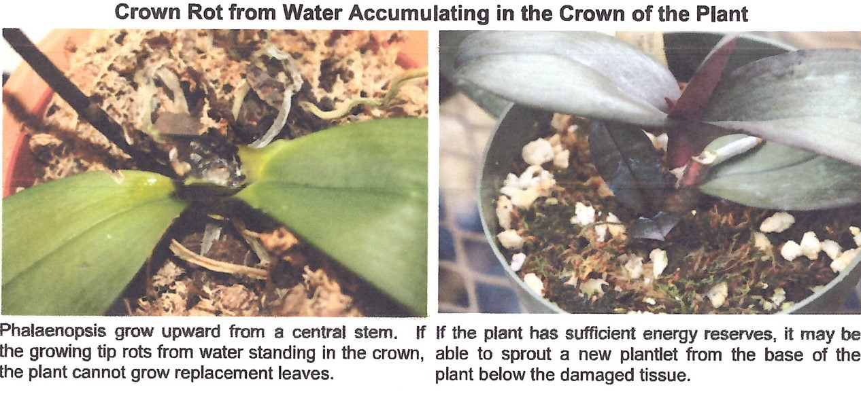
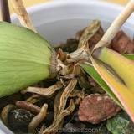
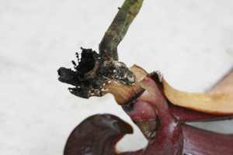
TREATMENT OF FUNGAL CROWN ROT ON PHALAENOPSIS
Fungal Crown Rot
Keiki from old Plant
Fungal Crown Rot is the most common and dangerous Phalaenopsis fungal disease. At its beginning, orchid owners may notice a subtle discoloration at the centre of the plant or at the base of the leaves. Crown rot is caused by a combination of overwatering, water left in crown, poor air circulation and low temperatures. If untreated, plants can die within a week.
To control this disease, even though it may be too late:
Immediately remove infected foliage using a sterilized razor. Relocate your orchid to expose it to better air circulation, lower humidity and temperatures. Spray your orchid with a good quality, broad-spectrum fungicide, following package directions. Even if you suspect a bacterial disease, fungicide application will prevent secondary infection.
Fungal Crown Rot

Slide 24
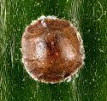
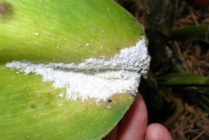
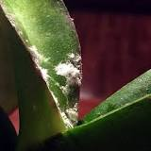
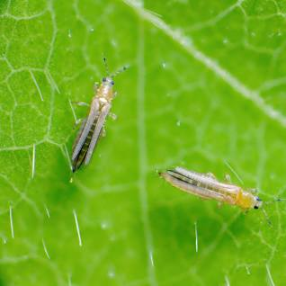
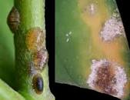
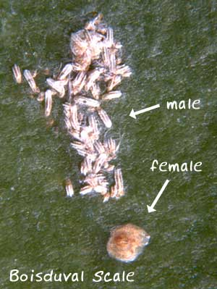
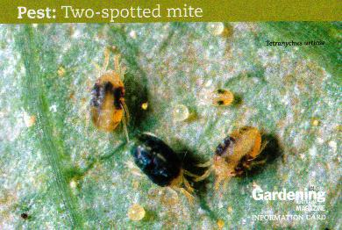
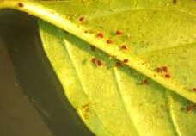
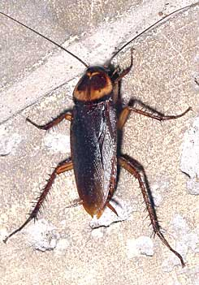
PESTS - MOST COMMON ENEMIES OF YOUR PHALAENOPSIS
Thrips
Mealybugs
Scale
Red Spider Mites
Cockroach

Slide 25


GOOD REFERENCE BOOKS ON GROWING PHALAENOPSIS

Slide 26



FLOWERS FROM MY OWN COLLECTION
THE END
PLANTS FROM MY OWN COLLECTION
Phal. Memoria Dave Penman

